Slide 1
I
PROJECT EXHIBITION 1

Slide 2
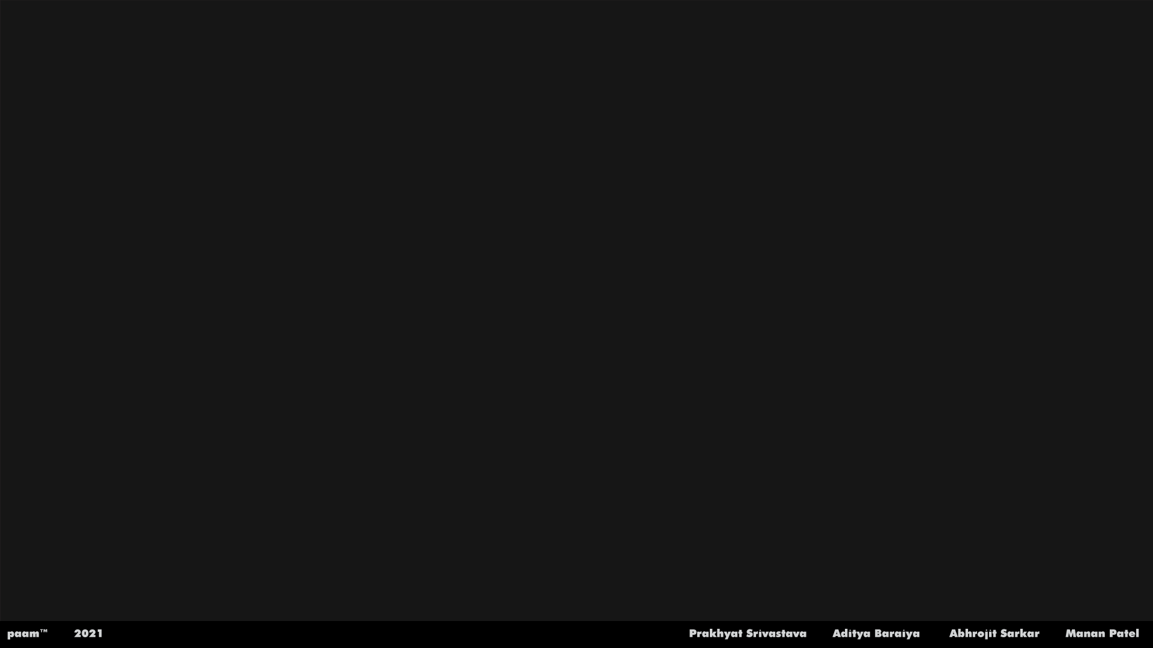
TEAM MEMBERS
20MIM10036 - Prakhyat Srivastava
20MIM10004 - Aditya Baraiya
20MIM10058 - Abhrojit Sarkar
20MIM10045 - Manan Patel

Slide 3

CHAT BOT USING NATURAL LANGUAGE PROCESSING AND ARTIFICIAL INTELLIGENCE

Slide 4
WHAT IS NLP ?
Natural Language Processing (NLP) is a field of Artificial Intelligence (AI) that makes human language intelligible to machines.
NLP combines the power of linguistics and computer science to study the rules and structure of language, and creates intelligent systems
run on machine learning and NLP algorithms, capable of understanding, analyzing, and extracting meaning from text and speech.

Slide 5
COMPONENTS OF NLP
1. Natural Language Understanding (NLU) :
Mapping the given input in natural language into useful representations.
Analyzing different aspects of the language.

Slide 6
COMPONENTS OF NLP
2. Natural Language Generation (NLG) :
Text planning : It includes retrieving the relevant content from knowledge base.
Sentence planning : It includes choosing required words, forming meaningful phrases, setting tone of the sentence.
Text Realization : It is mapping sentence plan into sentence structure.
( NLU is harder than NLG )

Slide 7
DIFFICULTIES IN NLU
NL has an extremely rich form and structure.
It is very ambiguous.
There can be different levels of ambiguity :

Slide 8
DIFFICULITIES IN NLU
1. Lexical Ambiguity : It is at very primitive level such as word-level.
E.g. : Treating the word “board” as noun or verb?

Slide 9
DIFFICULTIES IN NLU
2. Syntax Level Ambiguity : A sentence can be parsed in different ways.
E.g. : “He lifted the bottle with red cap.”
Did he use cap to lift the bottle or he lifted a bottle that had red cap?

Slide 10
DIFFICULTIES IN NLU
3. Referential Ambiguity : Referring to something using pronouns.
E.g. : Rima went to Gauri. She said, “I am tired.”
Exactly who is tired?
One input can mean different meanings.
Many inputs can mean the same thing.

Slide 11
LIMITATIONS OF EXISTING WORK
Chatbots are directly linked with businesses, so, understanding their weaknesses is a crucial part.
There are a plethora of limitations, users and business owners have complained about them.
Also, these limitations of chatbots have stopped various organizations from deploying chatbots on their applications and websites.

Slide 12
LIMITATIONS OF EXISTING WORK
1. They Can’t Make Decisions :
Another limitation of chatbots is that they lack decision-making.
They don’t have the right know-how to differentiate between the good and the bad.
On March 23, 2016, the tech biggie Microsoft attracted many controversies due to its chatbot Tay.
The chatbot posted offensive Tweets and landed Microsoft in huge troubles. So they have to shut down the chatbot temporarily.
Similarly, chatbots have done a lot of damage to multiple brands due to their poor decision-making capability.

Slide 13
LIMITATIONS OF EXISTING WORK
2. Chatbots Have the Same Answer For a Query :
Most customers don’t proceed with the chat when they know they are chatting with a chatbot.
Chatbots are easily identifiable because they have the same answer for multiple queries.
Suppose you are asking something to a bot that is not available in the data server so that you will get an apology.
The same is the case with other queries.
No matter how many different questions you ask, it will deliver you with the same apology, which is quite irritating.

Slide 14
PROPOSED WORK & METHODOLOGY
Successful chatbots are designed to learn, making maintenance an integral part of the chatbot development methodology.
Once the chatbot is interacting with real users it is important to analyze user feedback and sentiment, along with other insights the interactions may produce.
Insight analysis may give us an understanding of possible usability issues or areas of improvement, but it also may provide us with possible market opportunities to
implement more data-driven solutions.
Analytics can help us understand bot performance, user engagement, sentiment and demographics.
Fixing bugs and other software defects should be part of the software maintenance strategy, but with evolving customer expectations and technology advancements
it is important to also keep the system updated and sustainable.
Metrics for the machine learning components should always be monitored in order to address a possible decrease in performance.
In the case of chatbots, the ever-evolving nature of natural language may cause the NLP components to worsen over time.
Constant retraining, through active learning and evaluation of those components is vital during the maintenance and development process.

Slide 15
NOVELTY OF THE PROJECT
1. Paam Should Provide Faster Solutions :
paam can easily save time and effort. It can help resolve base level complex issues without student intervention.
Instead of having a student going through page after page and analyzing data.
One of the core features of paam should be to provide efficient solutions to student’s many problems on request.
2. We Keep a Simple & Easy User-Interface for paam :
paam is easy to find, proactive, engaging, and aesthetically appealing.

Slide 16
NOVELTY OF THE PROJECT
3. It helps the students who are facing problem to search information about college from their website:
Paam will help students where students can ask direct question and get their answers what they need.
4. Machine learning based system:
Paam will runs on neural network so it can compare and give answers correctly.

Slide 17
REAL TIME USAGE
1. It is used for automatic question answering.
2. It uses natural language recognition to deliver an appropriate response.
3. They learn from every interaction and over the time they understand how they should respond.
4. Can solve upto 80% of all routine queries.
5. Available 24/7 , they can speed up response time

Slide 18
REQUIREMENTS OF CHATBOT SOFTWARE
Our ChatBot is dependent on the following software:
- Visual Studio Code (to build the chat bot)
- Version 11.3.5.5Python 3.8.8 (64 bit)
- Microsoft .NET Framework v4.7.2. The system prompts for a restart to complete the update.
- Microsoft Visual C++ Redistributable 2017 x64 package

Slide 19
OBJECTIVE / PROBLEM STATEMENT
1. Paam will resolve all queries and satisfy the student to make right and helpful decision for himself.
2. Paam will help manage the questions that land in your inbox.
But they aren't tools for admissions, enrollment, or yield.
Paam is great for providing certain bits of information.
3. So the resolving problem is - all queries of students will resolve through The VIT Bhopal website and paam.

Slide 20
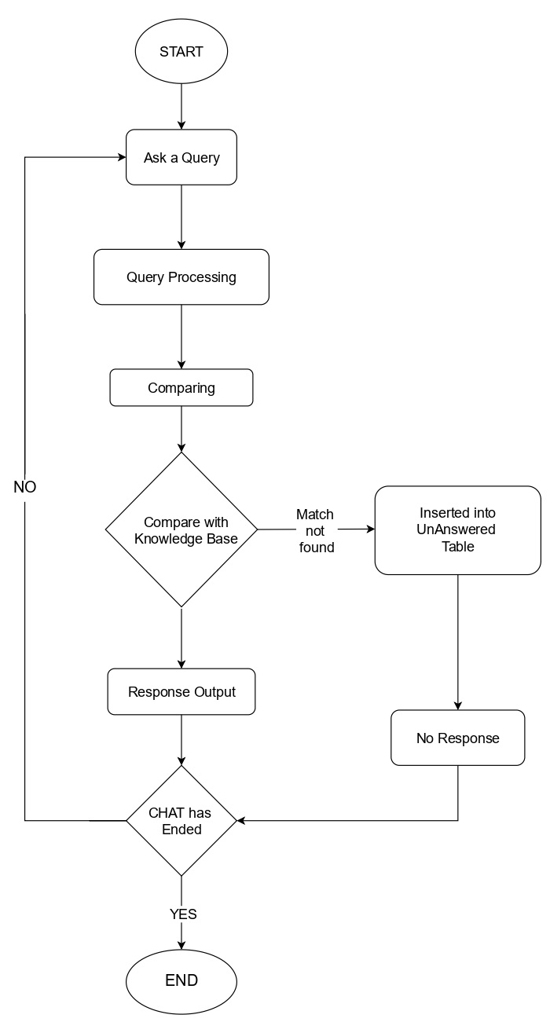
SYSTEM FLOW DIAGRAM

Slide 21
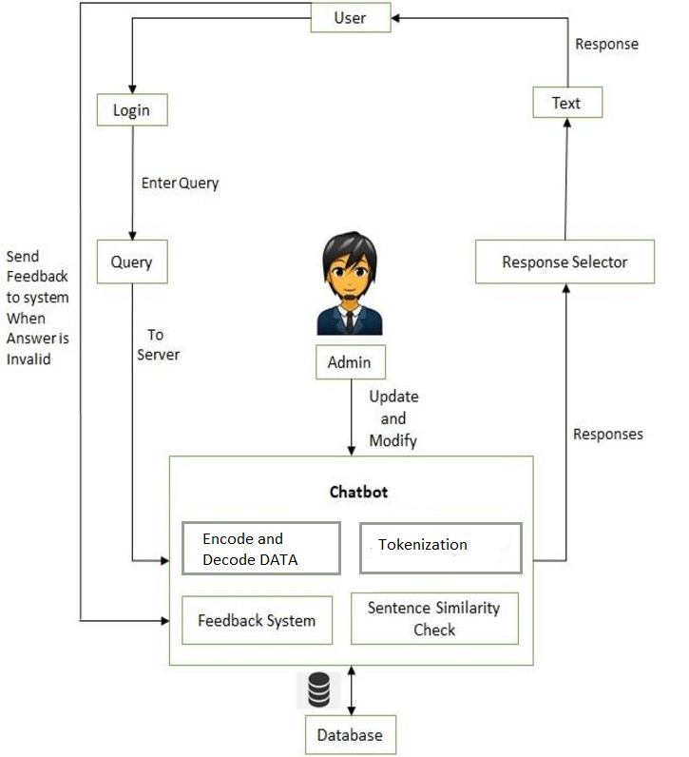
ARCHITECTURE DIAGRAM

Slide 23
Literature Review
Naeun Lee et al. [2017] proposed the implementation of word segmentation using Natural Language ToolKit. NLTK is a python package which caters to provide services for NLP. It has inbuilt tokenizers. Users need to import the package and use the required type of tokenizer which is present in the form of functions. The NLTK includes a wide range of tokenizers which are as follows: standard, letter, word, classic, lowercase, N-gram, pattern, keyword, path, etc. The most commonly used tokenizer is the word-punkt tokenizer which splits the sentences at the blank spaces. The accuracy, speed and efficiency of the NLTK tokenizers is commendable. Also, it does not require any algorithm implementation as the package executes them at the backend.
A review on Word Segmentation Segmentation, also referred to as tokenization, is the process of splitting text into smaller and meaningful units. These units could be paragraphs, sentences, clauses, phrases, words or letters. The smallest unit is the letter 24rs. Word segmentation is the splitting of sentences into individual words separated by blank spaces. The tokenized units of the sentences are called tokens. The tokenizers split the sentences into words and punctuation marks as independent units. The most commonly used tokenizer is of space type, i.e. it splits the sentences into words at the blank spaces. It is also required that the tokenizer should consider abbreviations, acronyms, dates, numbers in decimal formats, etc., which cannot split at punctuations and blank spaces, as they will lose their meaning if done so.

Slide 24
Literature Review
Mohammed Javed et al. [2015] explained a method to implement word segmentation. He proposed in his algorithm to calculate character spaces in the sentences. The character spaces should include all types of gaps between characters.They include the gaps between letters, punctuations and the words. The algorithm functions on the basis of the amount of gap or character space between each unit in the sentence. After the calculation of character spaces, an average of the gaps is calculated to know the mean average between characters in the sentence. This average gap distance is then applied to the sentence which is to be segmented. The places at which the character space is more than the average character space are said to be the points of tokenization. The gap between words is always more than the average gap and hence tokenization takes place at the blank spaces between words in the sentences.
A review on POS Tagging POS Tagging is the process of assigning grammatical annotations to individual words in the sentences. These annotations include the Parts-Of-Speech Tags. They denote the grammatical importance of the word in the sentence based on the dependency of that word with other words in that phrase, clause, sentence, paragraph, etc. The common POS tags are noun, verb, pronoun, etc. There are a number of ways which can be used to perform POS Tagging. Some of them are explained below. Jerome R. Bellegarda [4] [2010] proposed a method called latent analogy for POS Tagging. In this algorithm, latent semantic mapping (LSM) technique is used. It requires the training on the available corpus. The LSM maintains a feature space of the trained corpus which has been tagged. Now, new
sentences are provided to the LSM for tagging and the analysis is performed so as to determine the sentences from the training data which are closest to the test sentence. This is called a sentence neighborhood. Sentence neighborhood holds true for two sentences if they share the same intent matter. Once the intent matching sentences are found from the trained data, the POS tags attached to those sentences are then mapped to the test sentences.

Slide 25
Literature Review
Liner Yang et al. [2018] put forth the technique of implementing the POS Tagger using Neural Networks. This algorithm consists of “n” numbers of hidden layers. These layers are determined by the number of iterations or combinations required to tag the required sentence correctly. At each layer of the algorithm, each word in the sentence is tagged with an appropriate POS tag and then passed to the next later for checking the correctness of the tags. This keeps happening unless the next layer provides the same tags as provided by the previous layer. Another technique to implement the POS tagger is following the traditional approach i.e. of maintaining a dictionary of tags for the given language. Python NLTK provides an inbuilt Tagger which can be used just by importing the NLTK package. The NLTK has a pre-defined set of tags and trained data of its own. It tests the sentence and applies an appropriate tag to it. On comparing the above three algorithms, the NLTK tagger proves to be speed and usage efficient. But highest accuracy is provided by the neural network algorithm as it undergoes many iterations.
LinHua Gao et al. [2018] explains the traditional dictionary method of synonym extractions. In this method, the system database maintains a dataset of synonyms for important keywords in that domain. The sentence sent by the user is then mapped on to that synonym dataset. The keywords detected from the sentence are then checked in that synonym set to check for the same intent. All
possible synonyms of that keyword are then looked out for a match in the main database. The sentence which is closest to the user sentence is extracted. This method is time consuming and requires more storage and complexity.

Slide 26
Literature Review
Sijun Qin [2015] proposed a feature selection method for synonym extraction. In this method, among all the parts of speech tags, Words having the tags as nouns, verbs and adjectives are marked as positive tags and the others as negative tags. The polarity for Each feature (word) is then carried out by using the POS tags. If the overall feature polarity is positive, then it can be identified categorically. All the positive features are then grouped together and the synonyms detection for the group of features will be relatively strong, as an entire clause is checked for its synonymic meaning. The synonym sets which are extracted for that clause of features are then calculated for information gain. The one with the highest information gain is the strongest synonym extracted.

Slide 27
MODULE SPLIT UP & EXPLANATION
paam is working on some simple rules :
1. Read the data set
2. For accurate answers tokenize the words of tag of our dataset
3. Comparing to our dataset
4. How it works neural network
5. Response

Slide 28
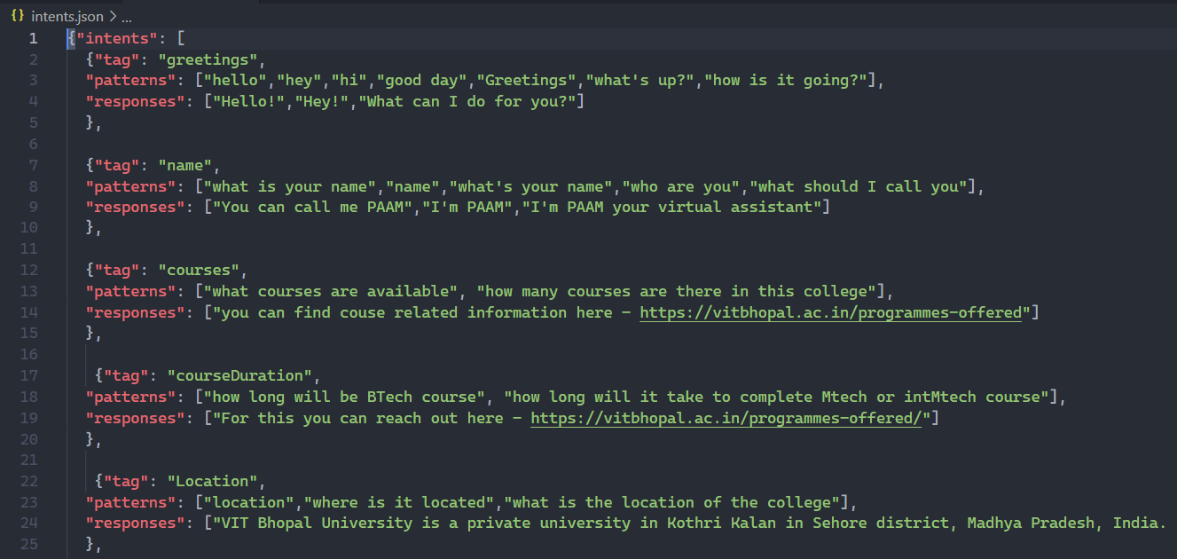
paam DATA SET

Slide 29

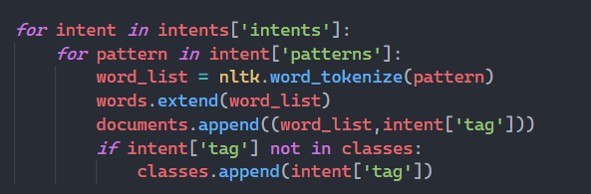
DATA SET
To read data set i.e. (json)
To accurate the answers paam will tokenize the words it means is just get all the words in our pattern with help of Natural Language Toolkit (nltk).

Slide 30
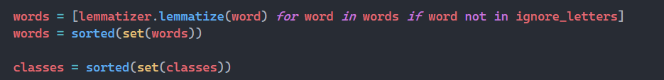
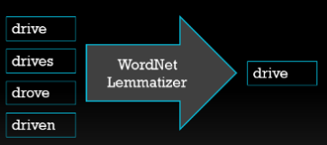
To remove duplicate elements. For decreasing the size of data set.
Lemmatizer is function that works for understanding the same meaningful words to get more accurate answers.

Slide 31
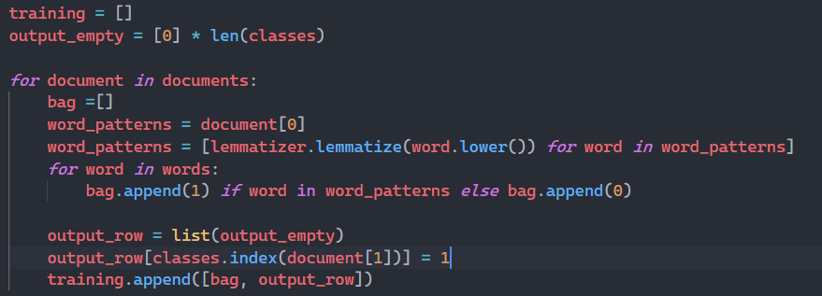
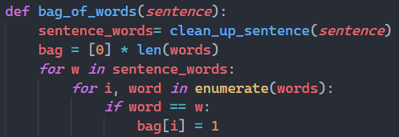

COMPARING TO OUR DATA SET
To check the word exist or not.
This will check that if word exist in our data set i.e. (bag) it will return 1 and if not it will return 0
After checking the word is correct it will append the word to bag and all the words which are in bag will process for giving the correct answer.

Slide 32
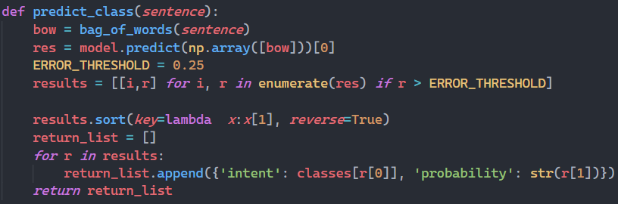
HOW IT WORKS
Through the neural network paam will predict and present the answer who has more compatible value for particular question that asked by student.
To understand how it is predict, consider how a neural network operates..
Assume there are multiple inputs so now to get the closest answer neural network has multiple layers inside and they are connected to each other.

Slide 33
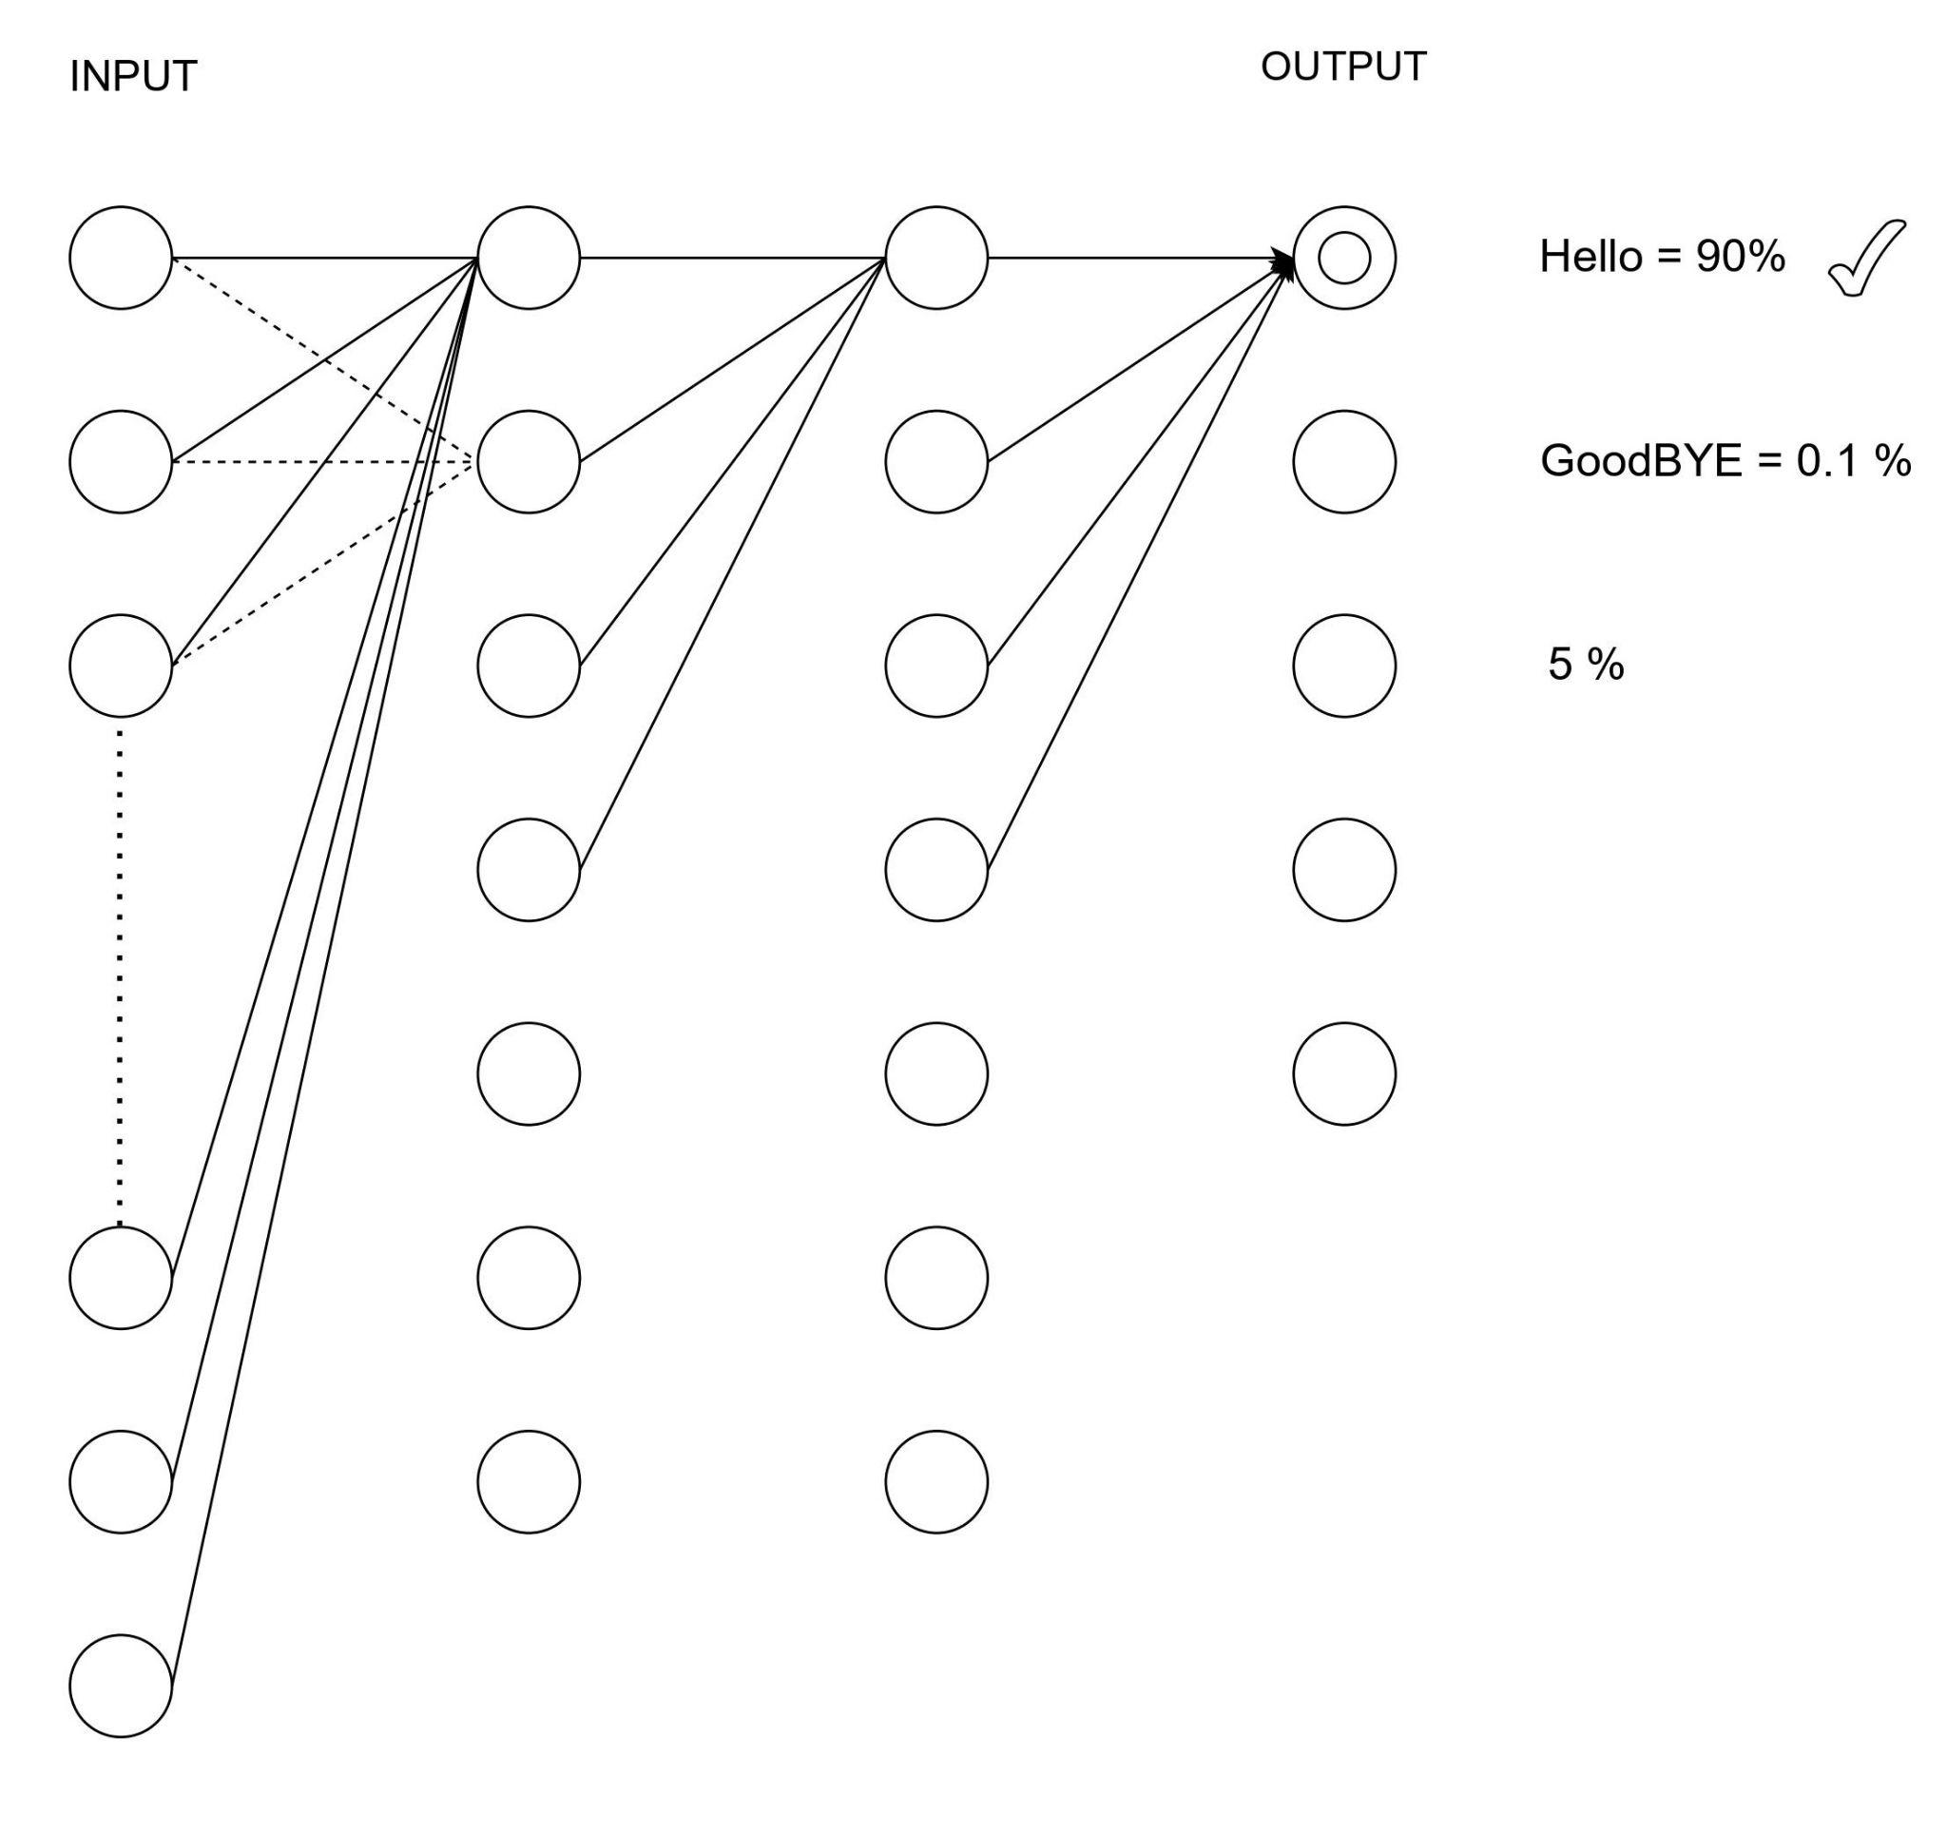
1. So all the inputs are connected to neurons so it will compare with
dataset and check which answer gets the high probability.
2. Our model is predicting which tag that we should take a response
from to give to the user.
3. The model will take in as a bag of words and as output we get some
kind of label us what we think we should respond with what tag it
comes from and that is how this basic model works .

Slide 34
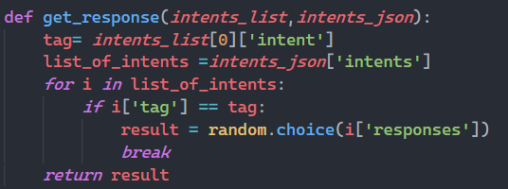
RESPONSE
To get response
This will gives the student random correct responses particular queries.

Slide 35

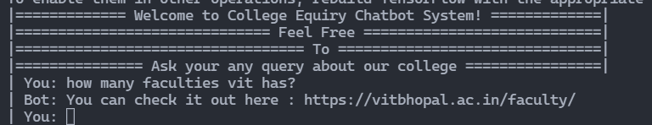
PROBLEM OF paam
We are trying to build self learning paam.
So that students will get accurate answers.
For that we have to give plenty amount of dataset to avoid errors.
Like this if we give the data to paam then it will recognise the data ,not get confused and give accurate answer.

Slide 36
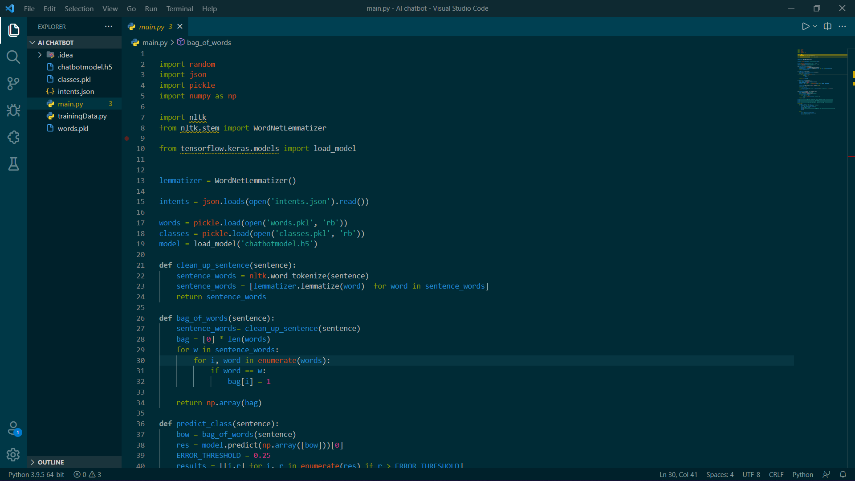
DEMO CODE

Slide 37
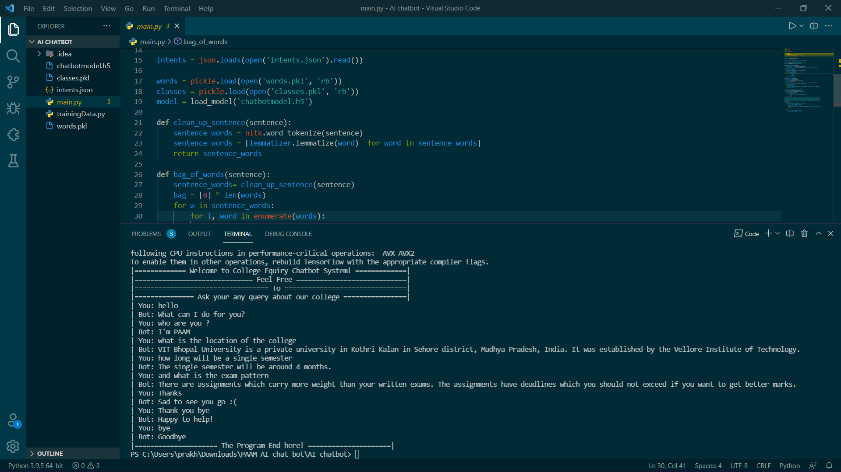
IMPLEMENTATION SCREENSHOT

Slide 38

REFERENCES
For our reference we are taking help from NeuralNine.
NeuralNine is a educational platform who helps the students who are willing to learn technical stuff.
NeuralNine - Let's Develop Brains
Chatbot using NLTK Library | Build Chatbot in Python using NLTK (analyticsvidhya.com)
Python Libraries for Natural Language Processing | by Claire D. Costa | Towards Data Science
Intelligent AI Chatbot in Python - YouTube

Slide 39
REFERENCES
Shin, K.G. and Mckay, N.D. (1984) ‘Open Loop Minimum Time Control of Mechanical Manipulations and its Applications’, Proc.Amer.Contr.Conf., San Diego, CA, pp. 1231-1236.
Mohammed Javed, P. Nagabhushan, B.B. Chaudhari, “A Direct Approach for Word and Character Segmentation in Run-Length Compressed Documents with an Application to Word Spotting”, 13th International Conference on Document Analysis and Recognition (ICDAR), 2015.
Naeun Lee, Kirak Kim, Taeseon Yoon, “Implementation of Robot Journalism by Programming Custombot using Tokenization and Custom Tagging”, 2017.
Sachin S. Gavankar, Sudhirkumar D. Sawarkar, “Eager Decision Tree”, 2nd International Conference for Convergence in Technology (I2CT), 2017.
Liner Yang, Meishan Zhang, Yang Liu, Maosong Sun, Nan Yu, Guohong Fu, “Joint POS Tagging and Dependency Parsing with Transition-based Neural Networks”, 2018.
https://pdfs.semanticscholar.org/90a9/93a09479705f63147eea427e0e048964dbf0.pdf?_ga=2.34781409.1975834925.1639895268-1134497788.1639895268

Slide 40




I
FIN.

